Slide 1
GreenSafe
Projet NodeJs
Zaitouni Youness
Furnon Clément

Slide 2
Contents of This Template
Here’s what you’ll find in this Slidesgo template:
A slide structure based on a presentation for a meeting, which you can easily adapt to your needs. For more info on how to edit the template, please visit Slidesgo School or read our FAQs.
An assortment of graphic resources that are suitable for use in the presentation can be found in the alternative resources slide.
A thanks slide, which you must keep so that proper credits for our design are given.
A resources slide, where you’ll find links to all the elements used in the template.
Instructions for use.
Final slides with:
The fonts and colors used in the template.
A selection of illustrations. You can also customize and animate them as you wish with the online editor. Visit Storyset to find more.
More infographic resources, whose size and color can be edited.
Sets of customizable icons of the following themes: general, business, avatar, creative process, education, help & support, medical, nature, performing arts, SEO & marketing, and teamwork.
You can delete this slide when you’re done editing the presentation.

Slide 3
Table of Contents
01
02
03
04
Project Schedule
Project Timeline
You can describe the
topic of the section here
You can describe the
topic of the section here
Status Report
Upcoming Report
You can describe the
topic of the section here
You can describe the
topic of the section here

Slide 4
Table of Contents
01
02
03
04
05
06
About the Project
Status Report
Project Timeline
You can describe the topic of the section right here
You can describe the topic of the section right here
You can describe the topic of the section right here
Upcoming Report
Project Stages
Our Team
You can describe the topic of the section right here
You can describe the topic of the section right here
You can describe the topic of the section right here

Slide 5
Project Schedule
01
Project Timeline
02
Status Report
03
Upcoming Report
04
You can describe the
topic of the section here
You can describe the
topic of the section here
You can describe the
topic of the section here
You can describe the
topic of the section here

Slide 6
01
Project Schedule
You can enter a subtitle here if you need it

Slide 7
01
Project Schedule
You can enter a subtitle here if you need it

Slide 8
Meeting Objectives
01
02
03
Despite being red, Mars is actually a cold place
Jupiter is the biggest planet in the Solar System
Venus is the second planet from the Sun

Slide 9
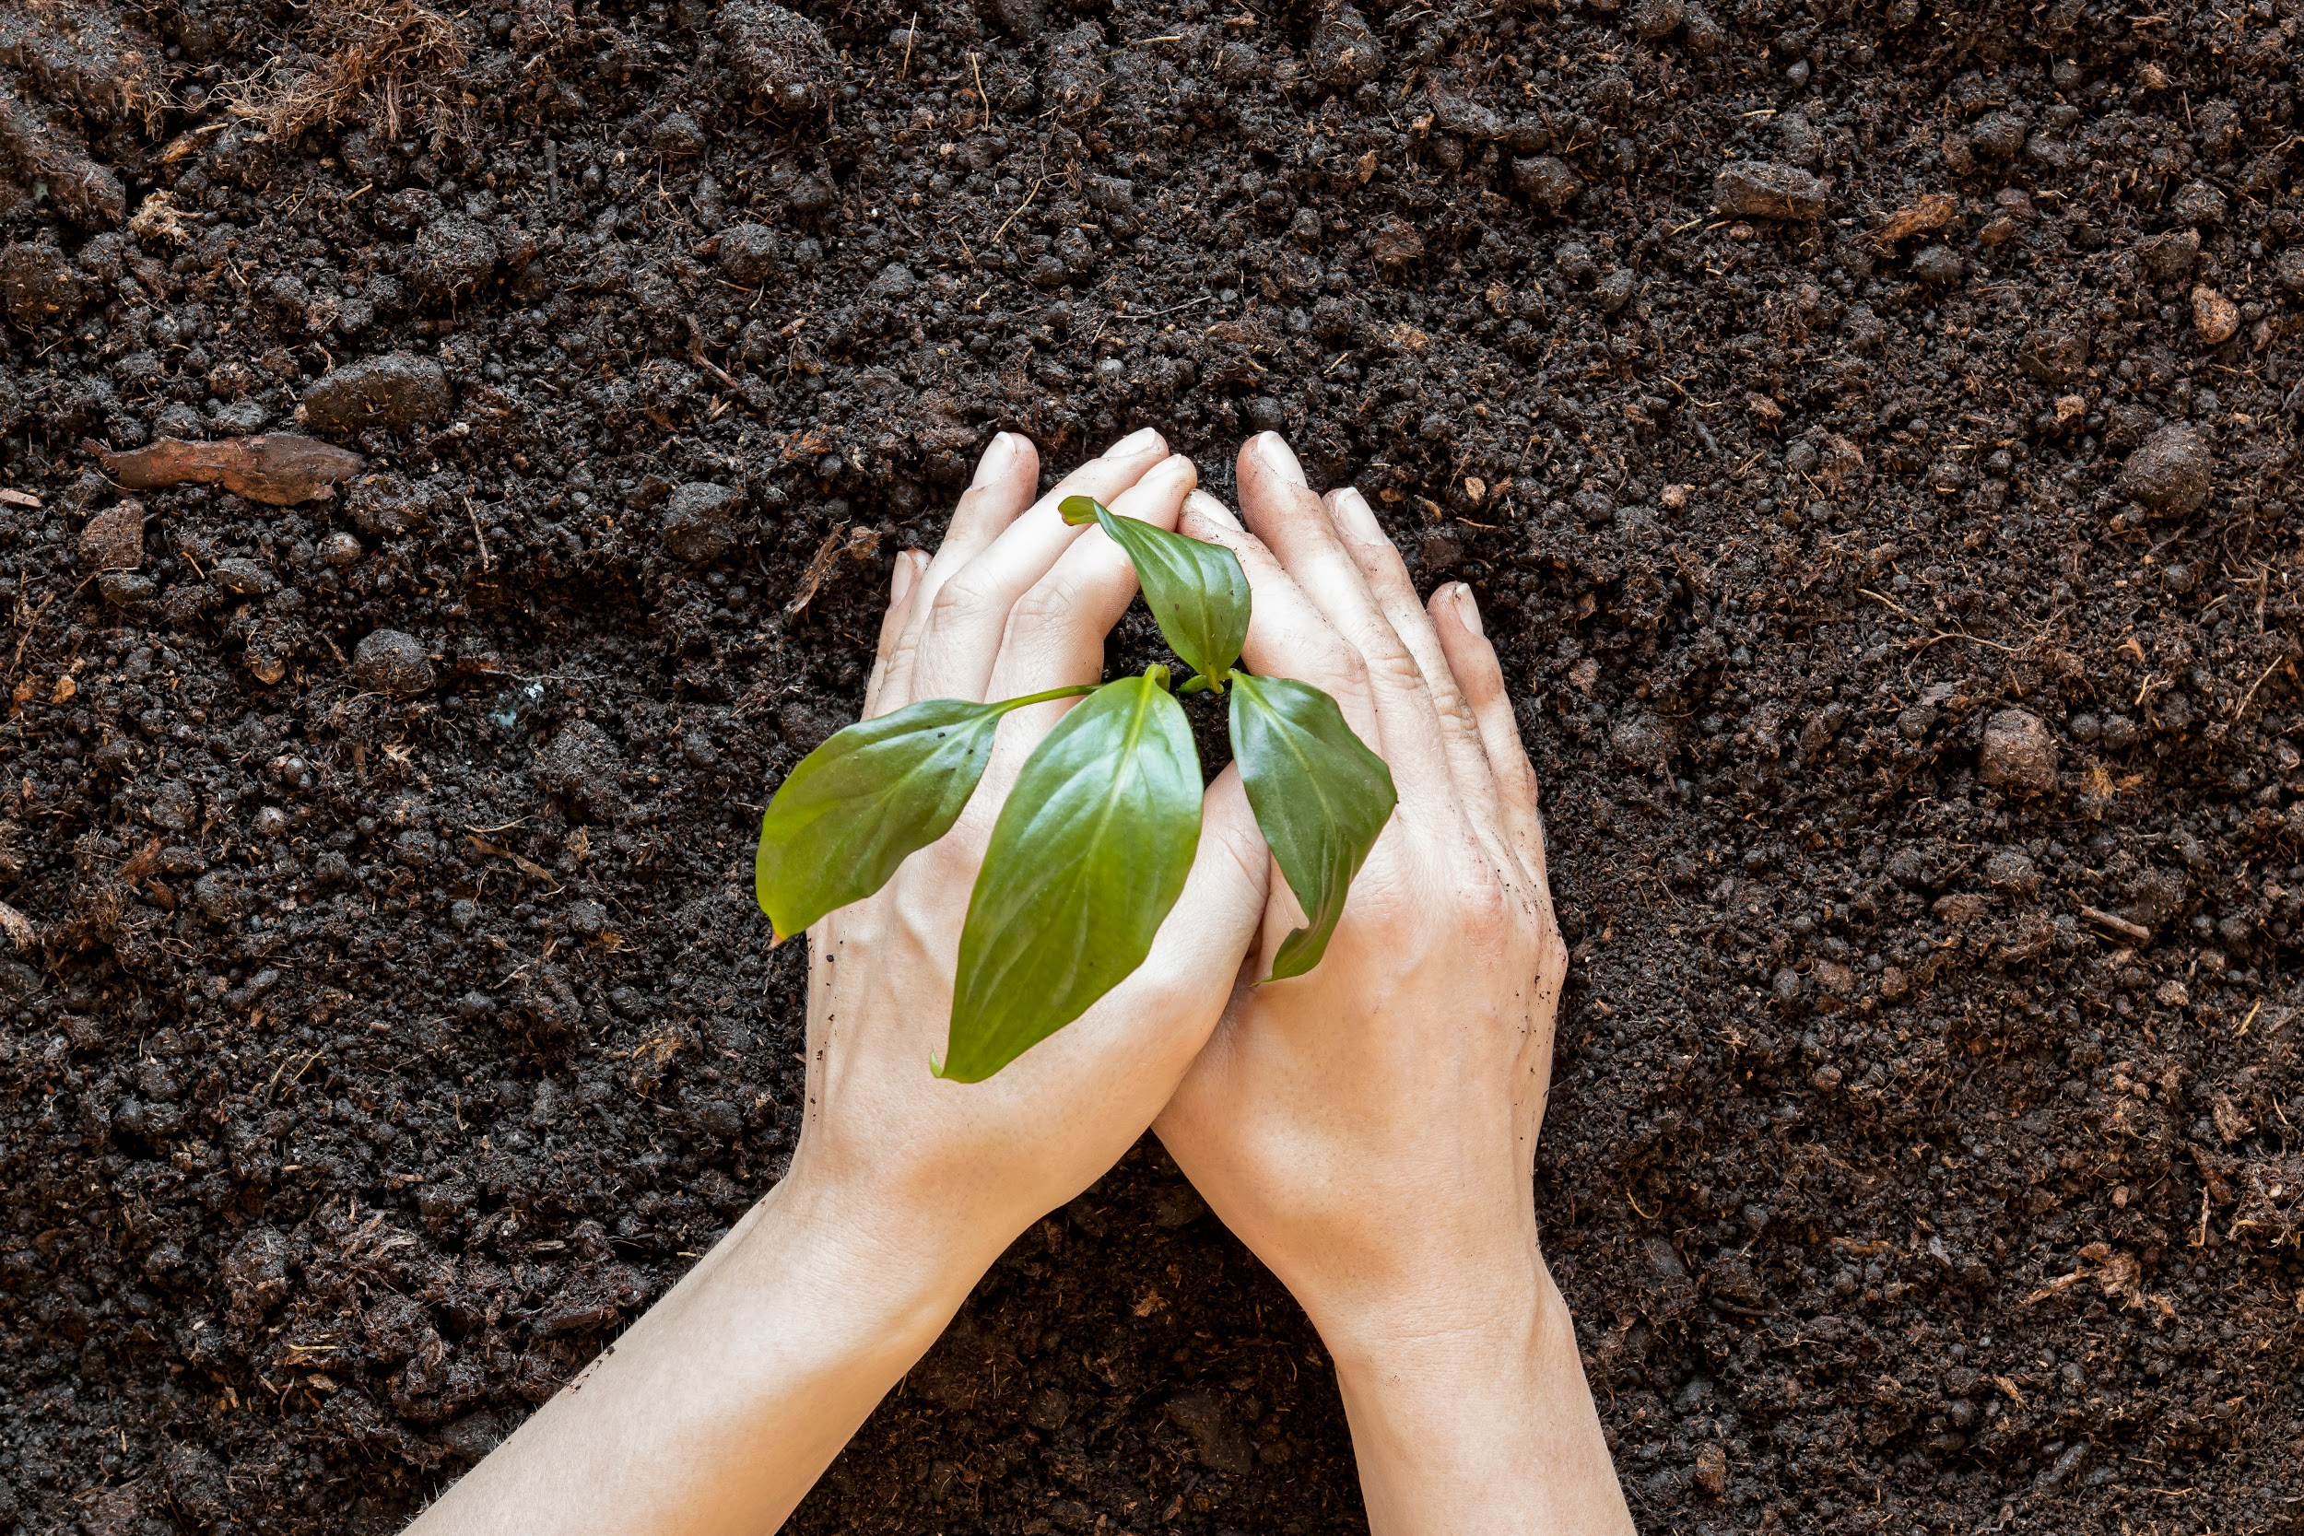
Meeting Objectives
Saturn
01
Mars
02
Mercury
03
Saturn is a gas giant, composed mostly of hydrogen and helium
Despite being red, Mars is actually a cold place full of iron oxide dust
Mercury is the closest planet to the Sun and the smallest one in the Solar System

Slide 10
Meeting Objectives
01
03
Jupiter
Saturn
02
04
Neptune
Mercury
Mercury is the closest planet to the Sun and the smallest
Saturn is a gas giant, composed mostly of hydrogen and helium
Neptune is the fourth-largest planet by diameter
Jupiter is a gas giant and the biggest planet in the Solar System

Slide 11
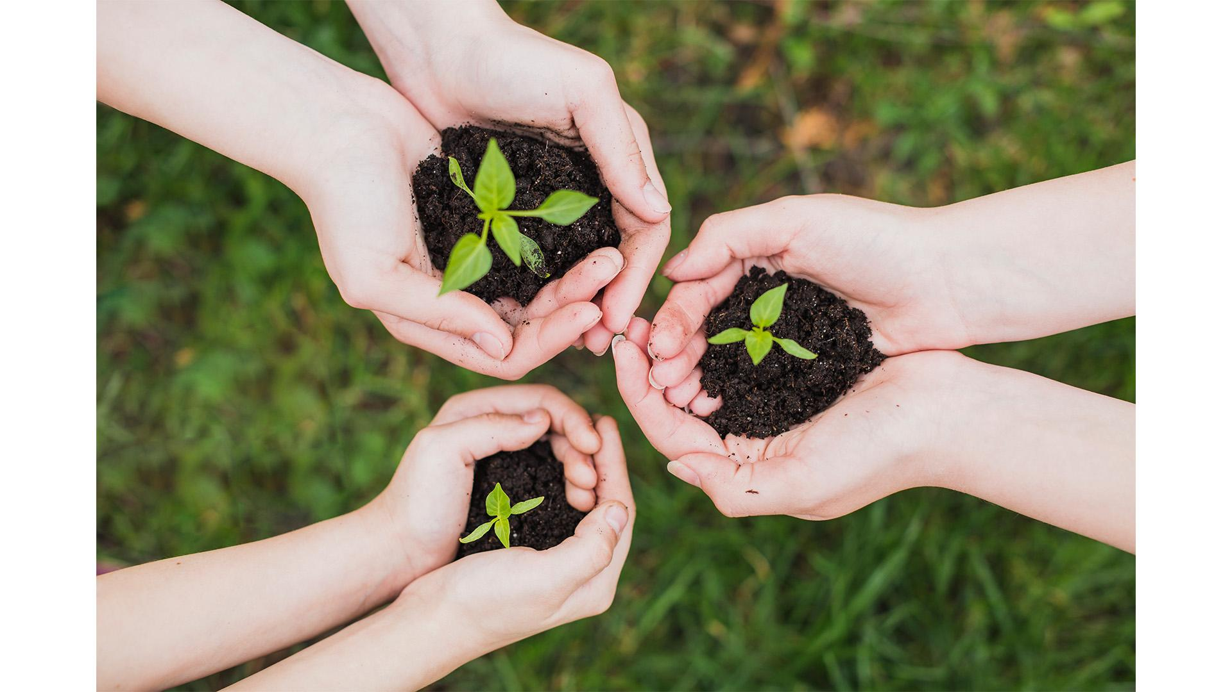
About the Project
Jupiter the biggest planet in the Solar System and the fourth-brightest object in the night sky

Slide 12
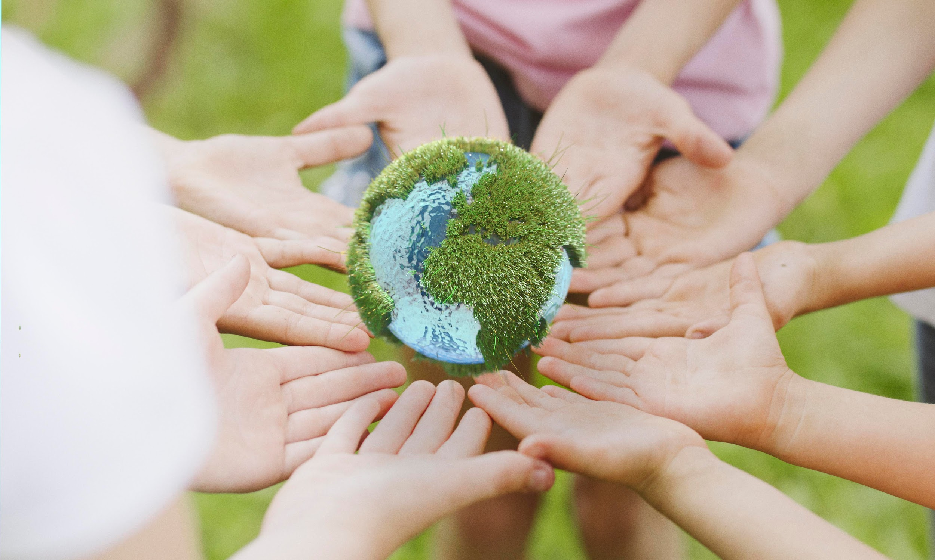
About the Project
Jupiter the biggest planet in the Solar System and the fourth-brightest object in the night sky

Slide 13
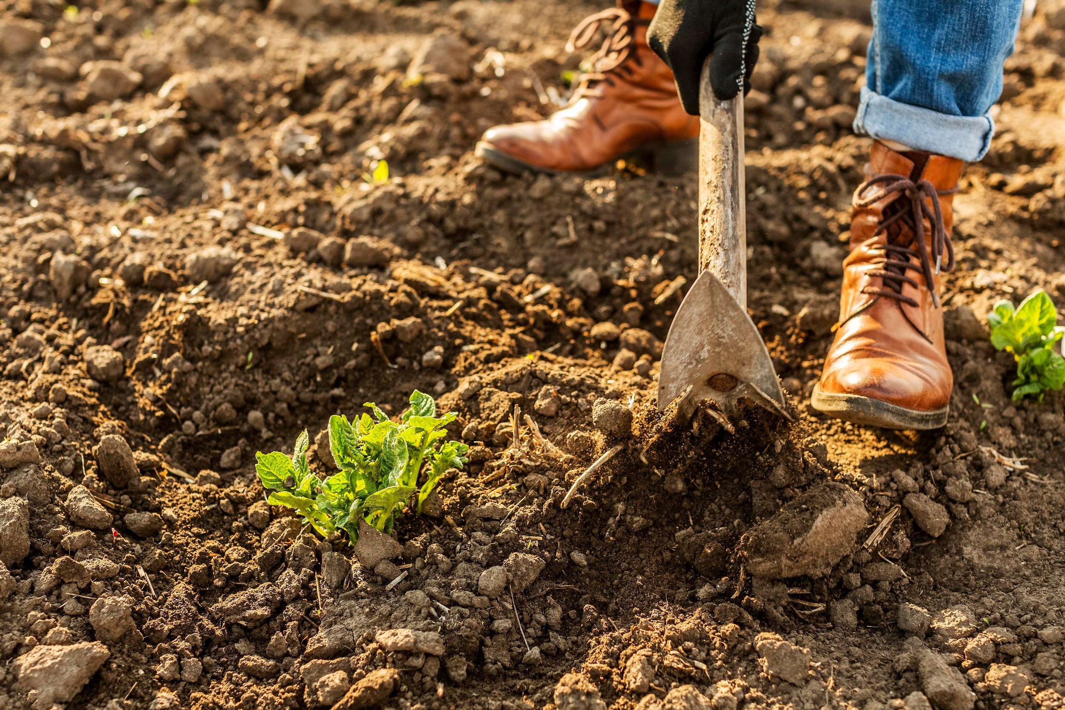
About the Project
Jupiter the biggest planet in the Solar System and the fourth-brightest object in the night sky

Slide 14
—Someone Famous
“This is a quote, words full of wisdom that someone important said and can make the reader get inspired.”

Slide 15
—Someone Famous
“This is a quote, words full of wisdom that someone important said and can make the reader get inspired.”

Slide 16
Project Schedule
Mon. | Tue. | Wed. | Thu. | Fri.
01 | 02 | 03 | 04 | 05
08 | 09 | 10 | 11 | 12
15 | 16 | 17 | 18 | 19
22 | 23 | 24 | 25 | 26
29 | 30 | 31
This is a calendar in which you can see important dates for the project

Slide 17
Project Schedule
Mars
mon | tue | wed | thu | fri
01 | 02 | 03 | 04 | 05
08 | 09 | 10 | 11 | 12
15 | 16 | 17 | 18 | 19
22 | 23 | 24 | 25 | 26
29 | 30 | 31
Despite being red, Mars is a cold place
Venus
January
It has a beautiful name and is the second planet
Mercury
Mercury is the smallest planet in the Solar System
Saturn
Saturn is the ringed planet. It’s a gas giant
This is a calendar in which you can see important dates for the project

Slide 18
02
Project Timeline
You can enter a subtitle here if you need it

Slide 19
02
Project Timeline
You can enter a subtitle here if you need it

Slide 20




Project Timeline
Phase 1
Phase 2
Phase 3
Phase 4
Mercury is a small planet
Earth is where we live on
Pluto is now a dwarf planet
Jupiter is the biggest planet

Slide 21
Project Timeline
Phase 1
Phase 2
Phase 3
Phase 4
Phase 5
Mercury is a small planet
Earth is where we live on
Pluto is now a dwarf planet
Jupiter is the biggest planet
Mars is a very cold place

Slide 22
Project Timeline
Phase 1
Mercury is a small planet
Phase 2
Pluto is now a dwarf planet
Phase 3
Earth is where we live on
Phase 4
Jupiter is the biggest planet

Slide 23
Checklist
 | Option 1 | Option 2 | Option 3 | Option 4 | Option 5
Environment
Alt. Energy

Slide 24
Checklist
Environment
Alt. Energy
Renewable
Sunlight
Option 1
Mars
Option 2
Venus
Mercury
Saturn
Option 3
m
Option 4
Saturn
Mars

Slide 25
KPI Dashboard
80%
Market
Trees
9M
People
70%
280
Parks
60%
Sales
Bins
90K

Slide 26
KPI Dashboard
Market
People
Sales
25%
48%
78%
Despite being red Mars is a cold place
Neptune is very far away from Earth
Mercury is the smallest of them all

Slide 27
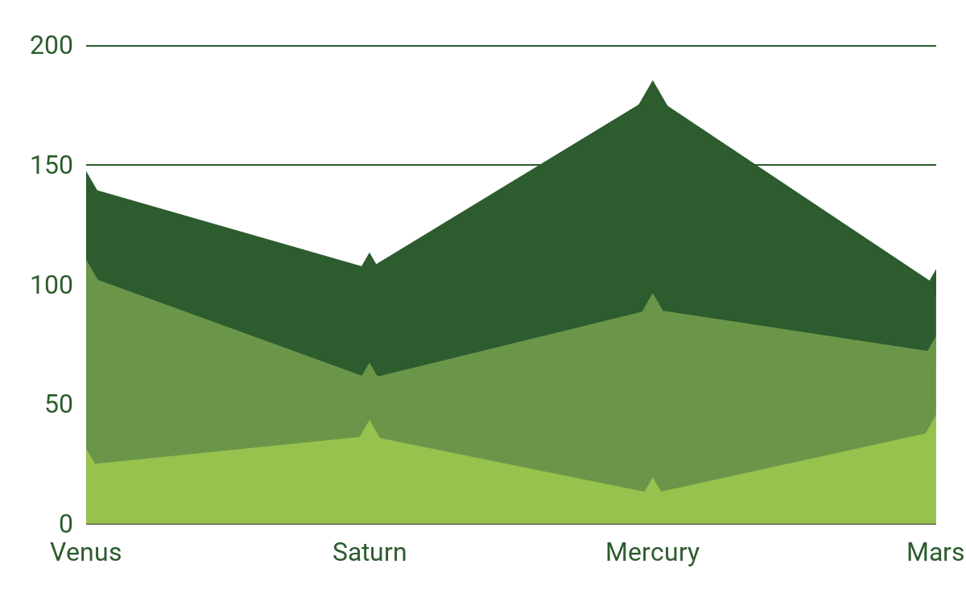
KPI Dashboard
Jupiter
60%
Jupiter is the biggest planet of them all
Saturn
30%
Saturn is a gas giant and has rings
Neptune
10%
To modify this graph, click on it, follow the link, change the data and paste the resulting graph here
It’s the farthest planet from the Sun

Slide 28
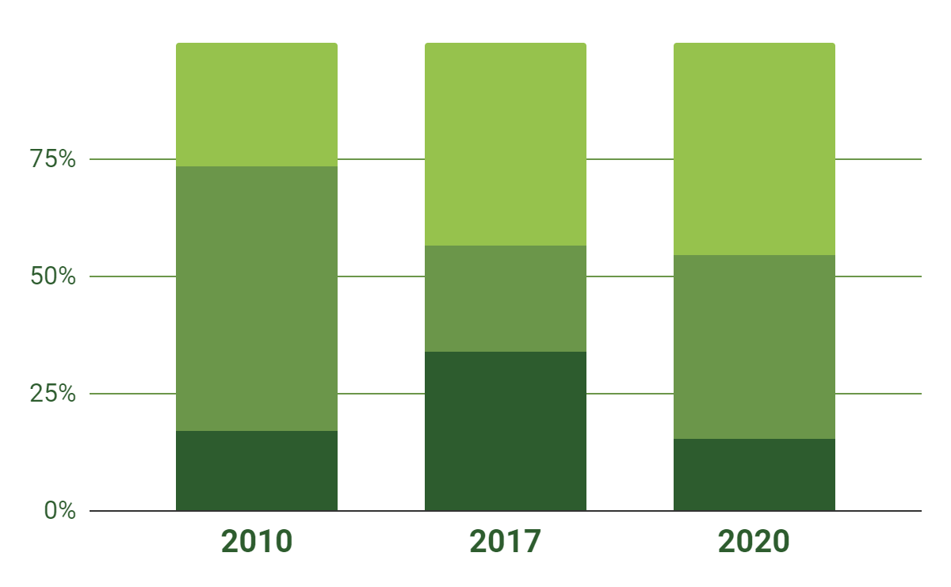
KPI Dashboard
Mercury
Mercury is the smallest planet of them all
70%
30%
10%
Mars
Despite being red, Mars is actually a cold place
Venus
Venus is the second planet from the Sun
To modify this graph, click on it, follow the link, change the data and paste the resulting graph here

Slide 29
03
Status Report
You can enter a subtitle here if you need it

Slide 30
03
Status Report
You can enter a subtitle here if you need it

Slide 31
RAID Summary
Risks
Issues
Mars is actually a cold place
Jupiter is the biggest planet
Assumptions
Dependencies
Venus has a beautiful name
Pluto is now a dwarf planet

Slide 32
RAID Summary
Risks
Issues
Assumptions
Dependencies
Mercury is the smallest planet in the Solar System
Despite being red, Mars is actually a cold place
Venus is the second planet from the Sun
Saturn is composed of hydrogen and helium

Slide 33
Summary
Mars
Saturn
Despite being red, Mars is actually a cold place full of iron oxide dust
Saturn is a gas giant, composed mostly of hydrogen and helium

Slide 34
Status Report
Schedule |  | The project schedule is mostly on track
Resourcing |  | Resourcing is adequate, but can be better
Budget |  | Project is within budget
Risks |  | All main project risks are under control
Issues |  | Project issues need to be solved
Benefits |  | Project benefits can be further improved

Slide 35
Status Report
Risks
It’s the smallest planet in the Solar System
90%
75%
Issues
25%
50%
Despite being red, Mars is actually a cold place
75%
Schedule
Resourcing
Budget
The project schedule is mostly on track
Resourcing is adequate, but can be better
The project must always be within budget
Benefits
Venus is the second planet from the Sun
50%

Slide 36
This Is a Map
Mercury is the closest planet to the Sun and the smallest one in the Solar System

Slide 37
This Is a Map
Mars
Despite being red, Mars is a cold place
Venus
It’s the second planet from the Sun
Mercury
It’s the smallest planet of them all
Saturn
Saturn is a gas giant and has rings

Slide 38
This Is a Map
Mars
Saturn
Despite being red, Mars is a cold place
It’s a gas giant and has several rings
Venus
Jupiter
It’s the second planet from the Sun
It’s the biggest planet of them all
Mercury
Neptune
Mercury is the smallest of them all
Neptune is very far away from Earth

Slide 39
Awesome
Words!

Slide 40
Awesome Words!

Slide 41
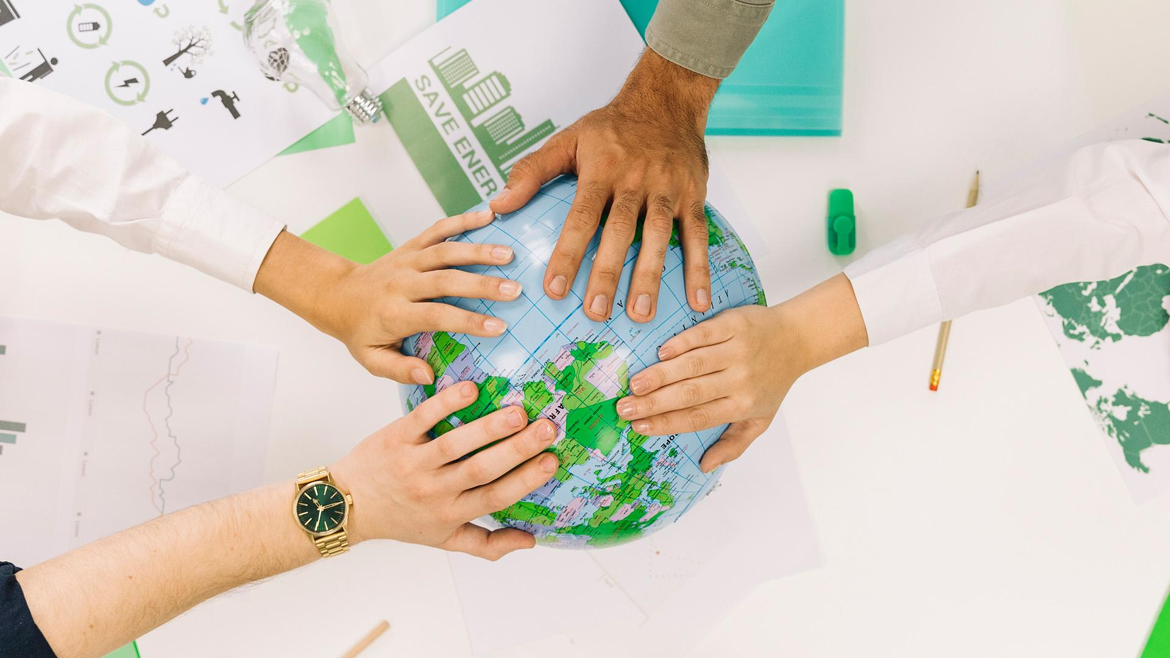
A Picture Is Worth a Thousand Words

Slide 42
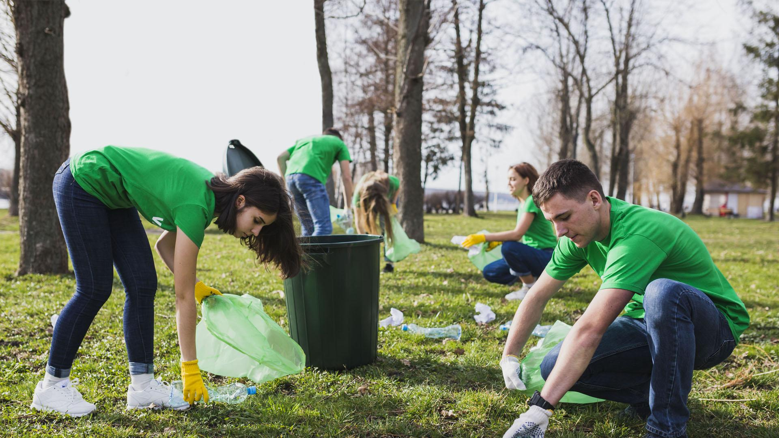
A Picture Is Worth a Thousand Words

Slide 43
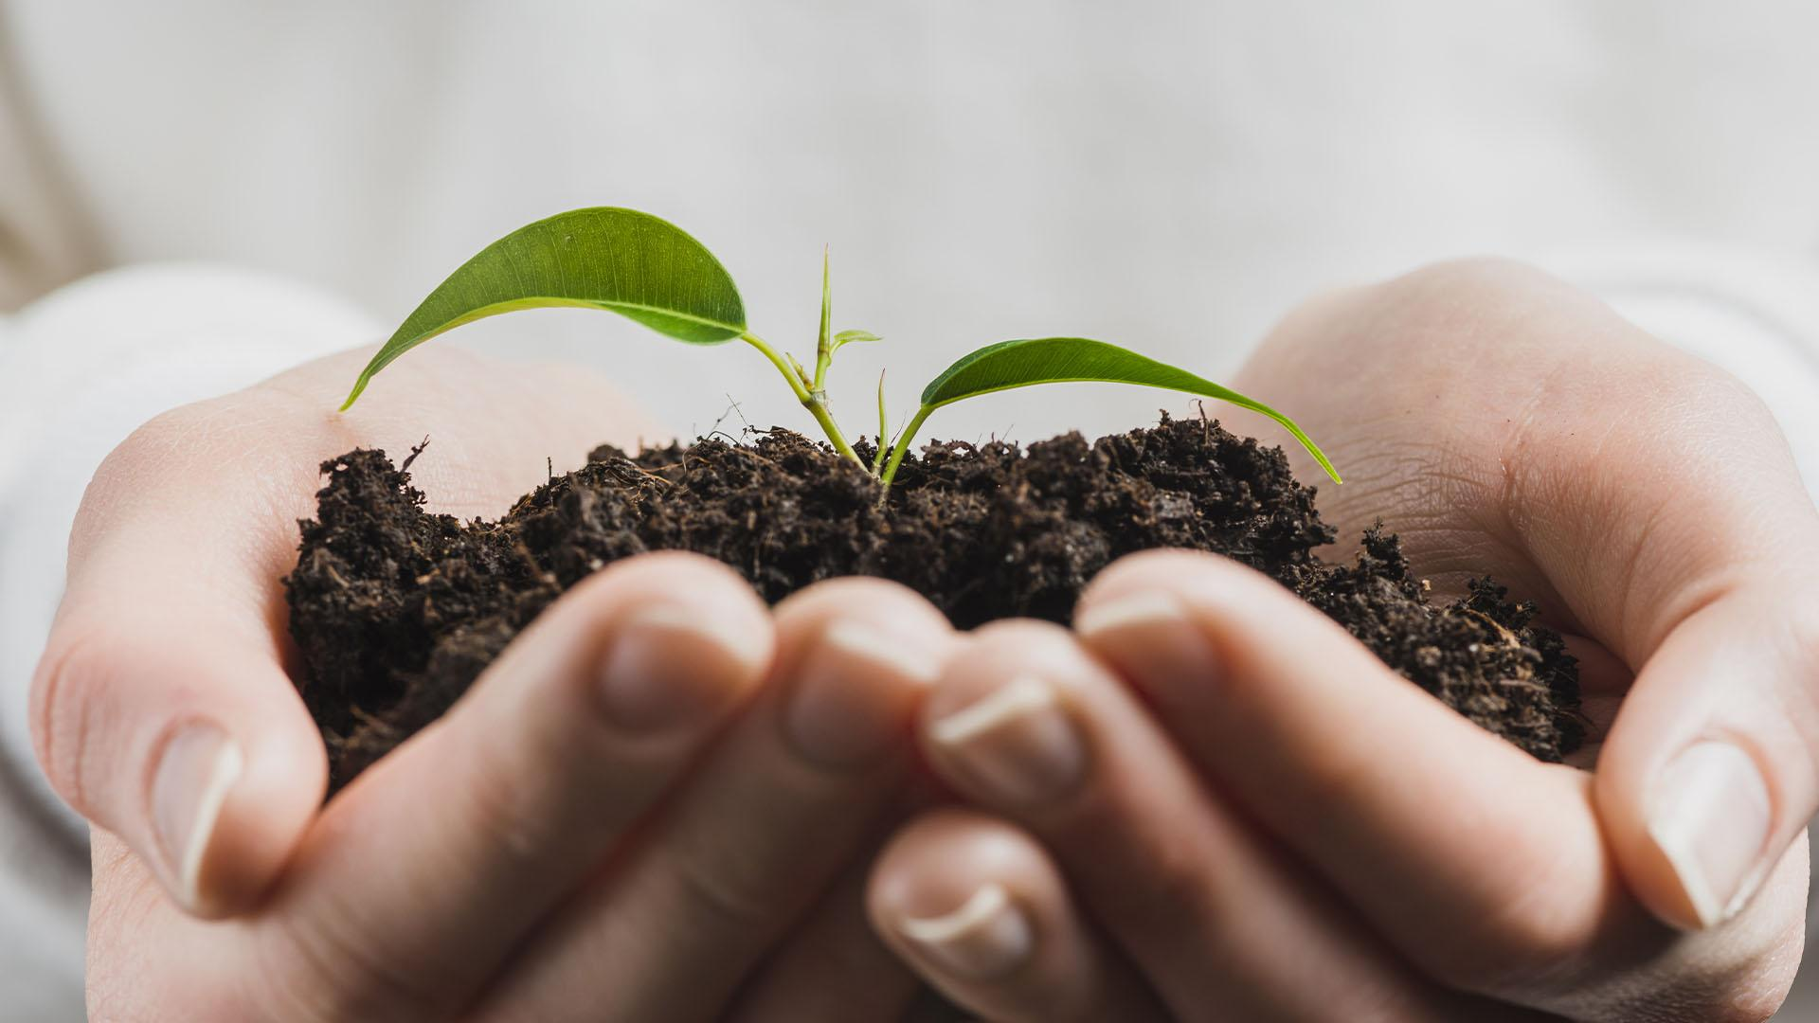
A Picture Is Worth a Thousand Words

Slide 44
Where We Are Now
Where We Want to Be
Mercury is the smallest planet in the Solar System
Jupiter is the biggest planet in the Solar System

Slide 45
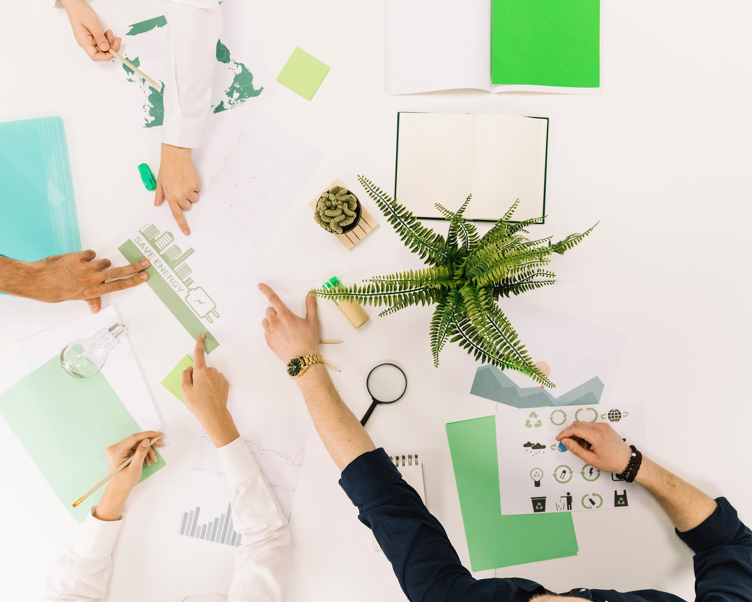
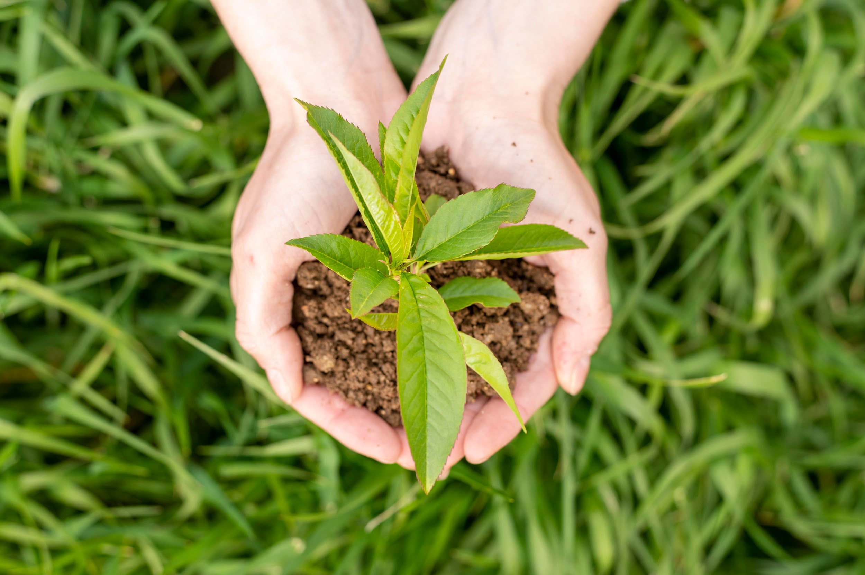
Where We Are Now
Where We Want to Be
Mercury is the smallest planet in the Solar System
Jupiter is the biggest planet in the Solar System

Slide 46
Where We Are Now
Where We Want to Be
Despite being red, Mars is actually a cold place full of iron oxide dust
Saturn is a gas giant, composed mostly of hydrogen and helium

Slide 47
04
Upcoming Report
You can enter a subtitle here if you need it

Slide 48
04
Upcoming Report
You can enter a subtitle here if you need it

Slide 49
Upcoming Events
FEB. 12
APR. 20
MAY. 4
AUG. 8
OCT. 5
DEC. 13
It’s the smallest planet in the Solar System
Despite being red, Mars is actually a cold place
It’s the biggest planet in the Solar System
It’s the farthest planet from the Sun
Venus is the second planet from the Sun
It’s composed mostly of hydrogen and helium

Slide 50
Upcoming Events
Feb. 12
Apr. 20
May. 4
Despite being red, Mars is actually a cold place full of iron oxide dust
Saturn is a gas giant, composed mostly of hydrogen and helium
Mercury is the closest planet to the Sun and the smallest of them all

Slide 51
8,400,000
Big numbers catch your audience’s attention

Slide 52
35.00%
Big numbers catch your audience’s attention

Slide 53

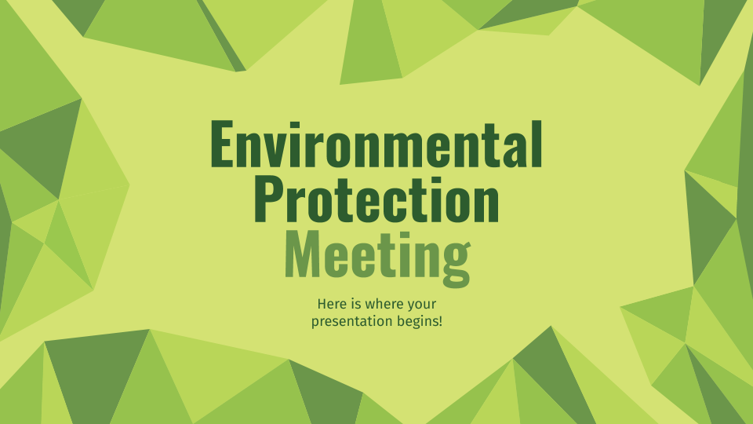
Media
You can replace the image on the screen with your own work. Just delete this one, add yours and center it properly

Slide 54
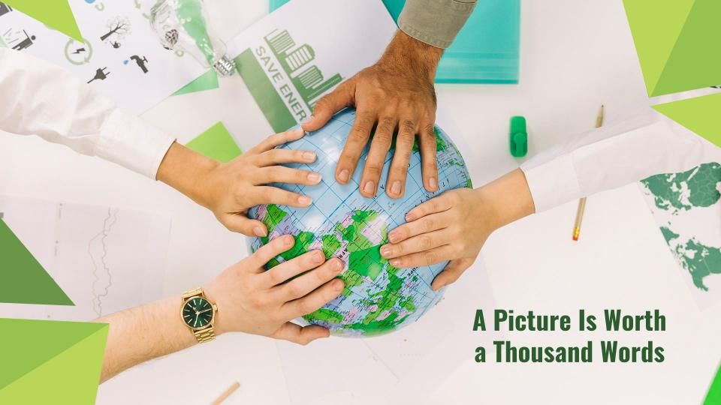
Media
You can replace the image on the screen with your own work. Just delete this one, add yours and center it properly

Slide 55
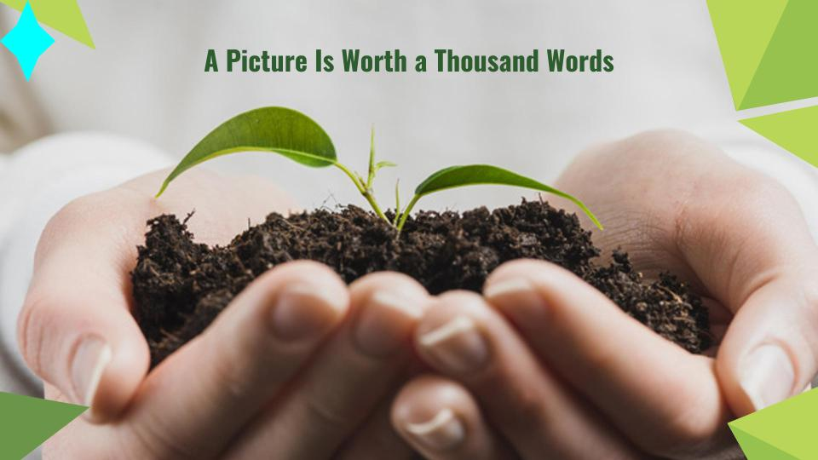
Media
You can replace the image on the screen with your own work. Just delete this one, add yours and center it properly

Slide 56


Our Team
Clever Charlene
Bright Barry
Despite being red, Mars is actually a cold place full of iron oxide dust
Saturn is a gas giant, composed mostly of hydrogen and helium

Slide 57
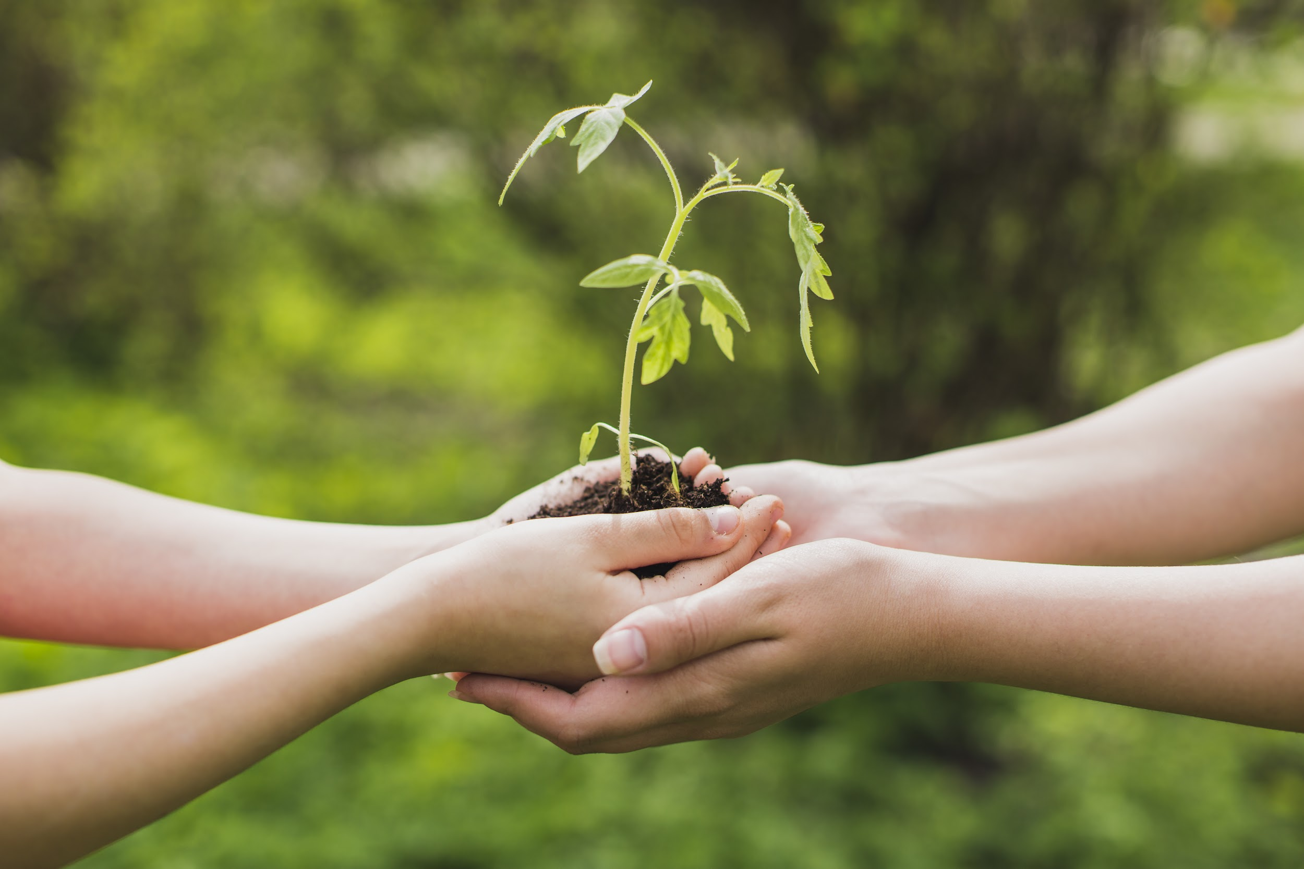
The Slide Title Goes Here!
Do you know what helps you make your point clear? Lists like this one:
They’re simple
You can organize your ideas clearly
You’ll never forget to buy milk!
And the most important thing: the audience won’t miss the point of your presentation

Slide 58
333,000.00
9h 55m 23s
386,000 km
Earths is the Sun’s mass
Is Jupiter’s rotation period
Is the distance between the Earth and the Moon

Slide 59
Whoa!
This can be the part of the presentation where you give an interesting anecdote to close the slideshow

Slide 60
Infographics Make Your Idea Understandable...
10%
20%
Mercury
Venus
Mercury is the smallest planet
Venus has a beautiful name
30%
40%
Jupiter
Mars
Jupiter is the biggest planet
Mars is actually a cold place

Slide 61
Thanks!
Do you have any questions?
youremail@freepik.com
+91 620 421 838
yourcompany.com
Please keep this slide for attribution.

Slide 62







Alternative Resources

Slide 63
Premium Alternative Resources

Slide 64
Alternative Infographic Resources
01
02
03
01
02
03

Slide 65
Resources
Photos
Vectors
Did you like the resources on this template? Get them for free at our other websites
Eco concept with hands holding small plants
Group of business people placing their hands on globe
Close-up of laptop on wooden post in park
Group of businesspeople fist bumping over desk
Group of businesspeople hand working on graph over white background.
Man with a laptop in a cornfield mock-up
Geometrical trees collection
Rural landscape in polygonal style
Geometric camping equipment
Environmental brochure
Polygonal country houses
Polygonal tree and mountains
Polygonal volcano erupting
Variety of low poly trees
Polygonal eco brochure
Polygonal mountain

Slide 66
Premium Resources
Photos
Vectors
Did you like the resources on this template? Get them for free at our other websites
Group of volunteers collecting garbage
Group of businesspeople discussing on energy saving in office
Person planting something in the ground
People holding an earth miniature
Hands holding small plant
Top view woman holding soil with plant in hands
Woman harvesting vegetables
Portrait of stylish traveller with hat smiling
Portrait of smiling man standing in park
Hand holding green sprout with soil
Earth globe in geometric design
Polygonal red horse geometric triangle design
Polygonal bird
Flat suns set
Save the planet concept
Flat design world environment day
Save the planet illustration design
Hands holding small plant

Slide 67
Instructions for use
In order to use this template, you must credit Slidesgo by keeping the Thanks slide.
You are allowed to:
- Modify this template.
- Use it for both personal and commercial projects.
You are not allowed to:
- Sublicense, sell or rent any of Slidesgo Content (or a modified version of Slidesgo Content).
- Distribute Slidesgo Content unless it has been expressly authorized by Slidesgo.
- Include Slidesgo Content in an online or offline database or file.
- Offer Slidesgo templates (or modified versions of Slidesgo templates) for download.
- Acquire the copyright of Slidesgo Content.
For more information about editing slides, please read our FAQs or visit Slidesgo School:
https://slidesgo.com/faqs and https://slidesgo.com/slidesgo-school

Slide 68
Fonts & colors used
This presentation has been made using the following fonts:
Oswald Bold
https://fonts.google.com/specimen/Oswald
Fira Sans Regular
https://fonts.google.com/specimen/Fira+Sans
#f2f8e9
#d4e273
#b9d658
#96c24d
#6b964a
#2d5c2e

Slide 69





Storyset
Create your Story with our illustrated concepts. Choose the style you like the most, edit its colors, pick the background and layers you want to show and bring them to life with the animator panel! It will boost your presentation. Check out How it Works.
Pana
Amico
Bro
Rafiki
Cuate

Slide 70
Use our editable graphic resources...
You can easily resize these resources without losing quality. To change the color, just ungroup the resource and click on the object you want to change. Then, click on the paint bucket and select the color you want. Group the resource again when you’re done.

Slide 73
JANUARY
FEBRUARY
MARCH
APRIL
MAY
JUNE
PHASE 1
Task 1
Task 2
PHASE 2
Task 1
Task 2
JANUARY
FEBRUARY
MARCH
APRIL
PHASE 1
Task 1
Task 2

Slide 76


